Slide 1
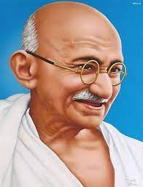
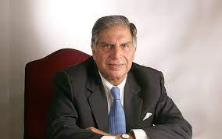
Personalities:-
1. Ratan Tata 2. Mahatma Gandhi

Slide 2
About Ratan Tata
Born on 28th December 1937 at Mumbai
Studied at cornell university , USA / Harward, USA
Father- naval tata
Mother- sooni tata
Parents got divorced when Ratan tata was 10 years old
Lived the whole life with his grandmother navajbai tata

Slide 3
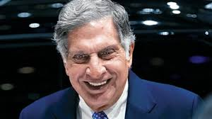
Personality traits
Industrialist
Investor
Philanthropist
Trained pilot
Padma Shri
Padma Vibhushan

Slide 4
How Ratan tata started his currier
First job at tata steel at Jamshedpur
lived life like a normal worked
Listed tata steel in new York stock exchange
Statement that is like gold to rattan tata
Deep insult = Steep result

Slide 5
Why is tata so big?
Tata has got the highest market capitalisation
Alone TCS is bigger than whole Pakistan stack exchange.
Contribute 4% to India GDP.
Approx 50000 crore tax is contributed by Ratan Tata every year.

Slide 6
Business strategies
Organic growth (new market , new technology , new customers)
In organic growth
EXIT struggling business (cosmetics,paint,oil,soap,pharma,cememt)
ENTER potential business ( retail,telecom,bio-tech,technology)
HOLD core business ( steel,motors,chemical,power)

Slide 7
What lessons I learned.
Always stand up on your words
Leadership is not position it is action
Nation before business
Biggest philanthropy
Health
Nutrition
Education
Water conservation
Skill development
Boosting sports
Providing scholarship
Donated 1500 crores for covid

Slide 8
About mahatma Gandhi
Full name- Mohan Das Karamchand Gandhi
Born on 2nd October 1869 at porbandar which is situated in Gujrat.
Father name- karamchand Gandhi
Mothers name- Putli Bai
Got married at age of 13 with Kasturba
At the age of 15 years Gandhi jii father got expired
At the age of 16 Gandhi jii became a father but unfortunately his son died soon due to some problem

Slide 9
Education qualifications
Started studying in raj court at the of 9
In 1887 he completed the high school from Ahmedabad
Then he went to London in 1888 to study about law
Then he returned to India in 1891
He roamed very much to find a job and finally got it in 1893 in tataabdula but for this job Gandhi jii needs to go to south Africa.
When Gandhi jii was there in south Africa it was the toughest time in his currier.

Slide 10
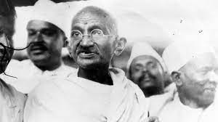
PERSONAILTY TRAITS
Leadership
Stabilizer
Influencer
Motivator
Harmonizer
Planner

Slide 11
MAJBUT YAA MAJBURI?
Compulsion due to responsibilities
Khilafat movement
Non cooperation movement
Dandi march
Gandhi Irwin impact
Choosing Nehru over Patel
India Pakistan partition

Slide 12
What lesson I learned?
Always do the right thing
Forgiveness, not revenge
Simple living
Cleanliness
See good in others

